Slide 1
Adaptive Fault-Tolerant Routing in Cube-Based Multicomputers Using Safety Vectors
Jie Wu,
IEEE TRANSACTIONS ON RARALLEL AND DISTRIBUTED SYSTEMS, APRIL 1998, page 321~334
Presenter: Chiao-Wei Chiu (邱喬偉)
Date: Aug. 2, 2006

Slide 2
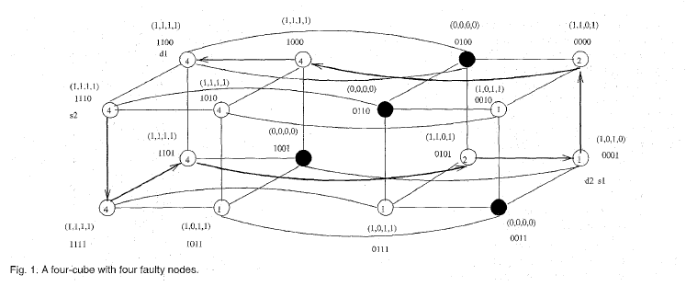
Hypercube
n-cube (Q_{n}) is a graph having 2^{n} nodes
labeled from 0 to 2^{n}-1
For example:
in 4-cube
let s = 0111, then s(4) = 0, s(3) = 1, s(2) = 1, s(1) = 1
Neighbors:
s⁽⁴⁾ = 1111,
s⁽³⁾ = 0011,
s⁽²⁾ = 0101,
s⁽¹⁾ = 0110

Slide 3
Hamming distance
H (s, d) = Hamming distance of (s, d)
s = 0111, d = 0010
H (s, d) = | s ⊕ d | = | 0101 | = 2
dimensions 3, 1 are preferred dimensions ;
dimensions 4, 2 are spare dimensions.
Among neighbors o s = 0111,
nodes s⁽³⁾ = 0011, s⁽¹⁾ = 0110 are preferred neighbors ;
s⁽⁴⁾ = 1111, s⁽²⁾ = 0101 are spare neighbors.
Any path from s to d that uses links at dimensions 3 or 1 in some order is a minimal path, e.g.,
0111 → 0110 → 0010

Slide 4
Dynamic Adaptivity
A minimal routing algorithm is k-adaptive at intermediate node s with respect to destination node d if it can select the next forwarding node among k neighbors of node s which are along minimal paths from node s to node d.
H (s, d) = k , d is k-adaptive at s

Slide 5
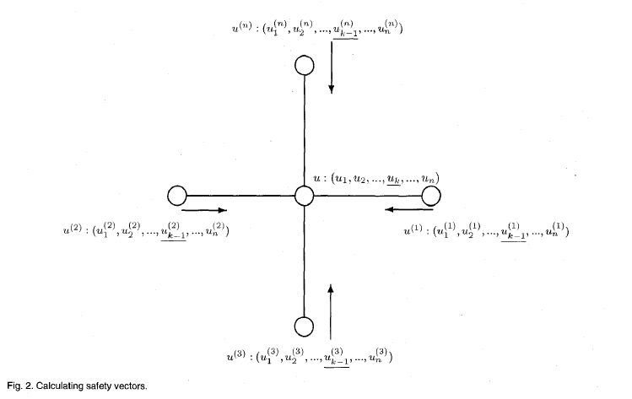
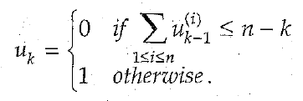
Safety Vectors
(u₁,u₂,…,u_{n}) is the safety vector
Base for the first bit:
u₁ = 0 , if node u is an end node of a faulty link
u₁ = 1 , otherwise
Inductive definition for the kth bit:

Slide 6
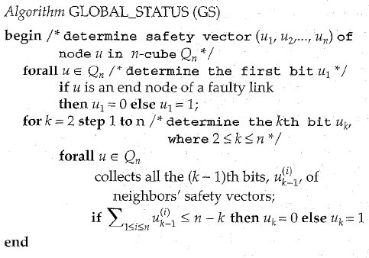
Algorithm for Calculation

Slide 7
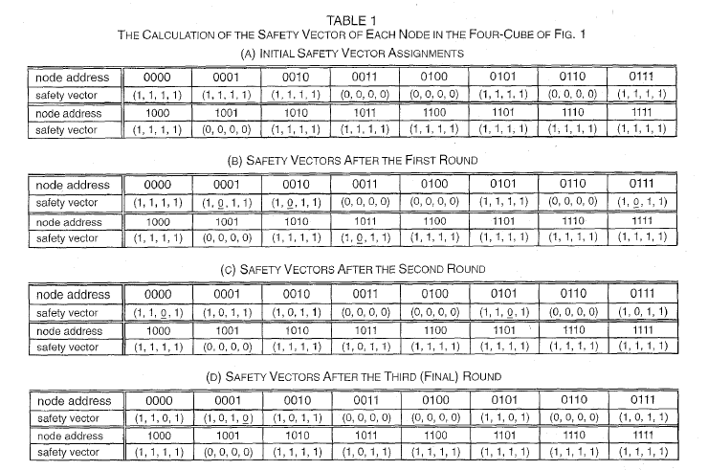
Calculation of
Fig. 1

Slide 8
Theorems
Given an n-cube, the safety vector of each node can be determined through n-1 rounds of information exchange between neighboring nodes.
Assume that (u₁,u₂,…,u_{n}) is the safety vector associated with node u in a faulty n-cube.
If u_{k} = 1, then there exists at least one Hamming distance path from node u to any node which is exactly k-Hamming-distance away.

Slide 9
Safety Level
The safety level of a faulty node is zero.
For a non-faulty node u, let (S₀,S₁,S₂,…,S_{n-1}), 0 ≦ S_{i} ≦ n, be the non-decreasing safety level sequence of node u’s n neighboring nodes in an n-cube.
if (S₀,S₁,S₂,…,S_{n-1}) ≧ (0,1,2,…,n-1) ,then S (u) = n
else if (S₀,S₁,S₂,…,S_{k-1}) ≧ (0,1,2,…,k-1) && S_{k} = k-1,
then S (u) = k

Slide 10
Properties of Safety Vectors
In an n-cube with no more than n-1 faulty nodes and no faulty links, each non-faulty but unsafe node has a safe neighbor.
If the safety level of a node is k(0 < k ≦ n), then there is at least one Hamming distance path from this node to any node within k-Hamming-distance.

Slide 11
Theorems
Assume that k is the safety level of node u in an n-cube and (u₁,u₂,…,u_{n},u_{n+1}) is the safety vector of node u, then
k <= min {i | u_{i+1}=0}
In an n-cube, assume that W is the number of faulty nodes and V is the number of faulty links.
If W + 2V < n, then every non-faulty node that does not have an adjacent faulty link has a safe neighbor.
Extra bit u_{n+1} = 0

Slide 12
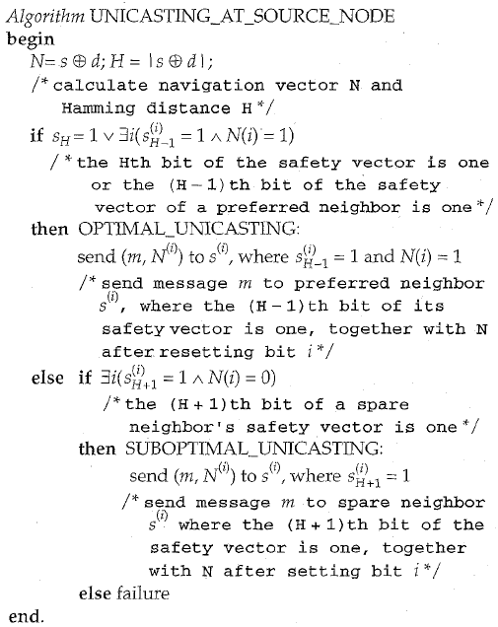
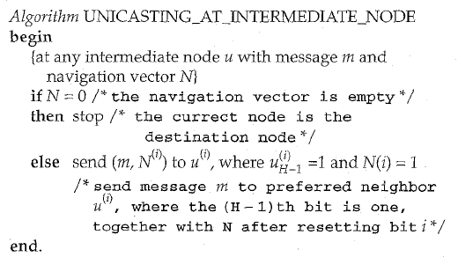
Routing Algorithm
(1,1,1,1)
1100
(1,0,1,0)
0001
(1,1,1,1)
1101
(1,0,1,1)
1011

Slide 13
Updating Safety Vectors
Demand-driven
when a node detects an inaccurate safety vector
2) Periodic
each node exchanges safety information periodically
3) State-change-driven
when a node detects a status change of a neighboring node or link

Slide 14
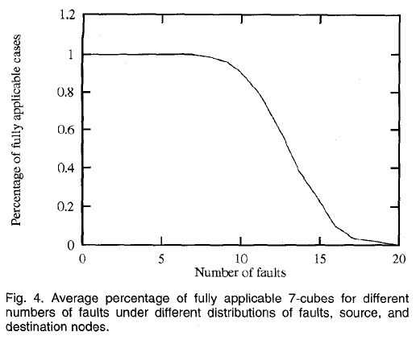
Adaptivity Analysis
When the number of faults
in 7-cubes reaches 9,
the percentage is still
close to 100%

Slide 15
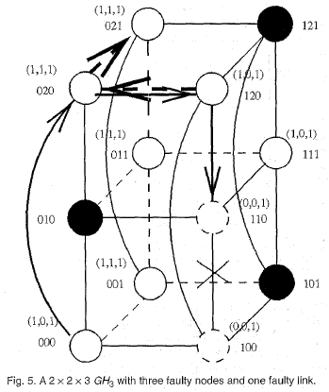
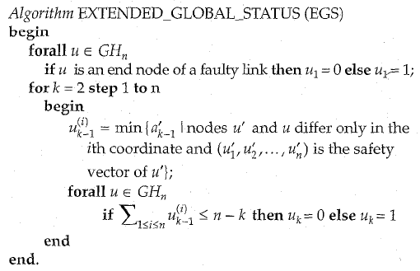
Generalized n-dimensional hypercube (GH_{n})
In A 2 x 2 x 3 GH₃
EGS requires 2(n-1) rounds to
obtain the safety status of each nodes in GH_{n}

Slide 16
References
Adaptive Fault-Tolerant Routing in Cube-Based Multicomputers Using Safety Vectors, 1998
Fault-Tolerant Routing Based on Safety Path Vectors in Hypercube System ,2004

